Slide 1
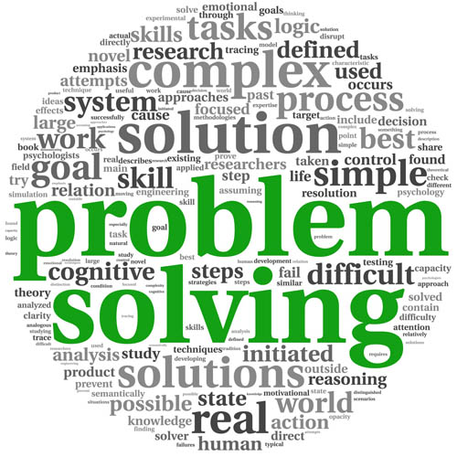

Using COMPUTERS (CSE-1002)
Introduction to the course

Slide 2
Opening remarks
Greetings
Importance of the course
Connection between the course and real world applications

Slide 3
CSE-1001/1002- Problem Solving Using Computers (PSUC)
Course modules
Introduction to Computer Hardware and System Software Concepts (1 Hr)
Problem solving Techniques (3 Hrs)
Introduction to Basics of Programming (3 Hrs)
Operators and Expressions (4 Hrs)
Control Structures (4 Hrs)
Arrays & Strings (6 Hrs)
Structured Programming – Functions (6 Hrs)
Structures and Pointers (4 Hrs)
Introduction To Object Oriented Programming (3 hrs)
Cyber Security(2 hrs)
Course Plan

Slide 4
Course Facilitation
Teaching Methodology
Power point presentation and Blackboard
Course Plan
Study Material and other Resources
Faculty team
Course coordinator
RAJESH GOPAKUMAR
Dept. of CSE, MIT Manipal
Faculty member

Slide 5
Faculty member Details
Name : Name of the faculty
Designation :
Department :
Cabin No. :
Location :
Email-Id :
Available timing : Day and time

Slide 6
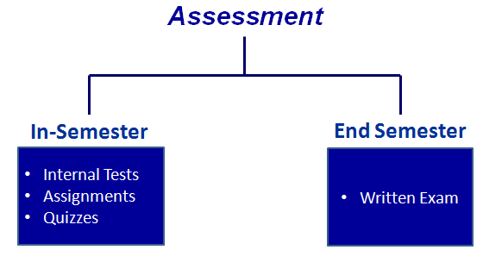
Assessment methodology

Slide 7
Assessment plan (Theory)
In Semester Assessments - 50 %
Written tests: Two tests of 15 marks each
(Max Marks: 30)
Surprise quizzes/assignments: Five q/a of 4 marks each
(Max Marks: 20)
End Semester Examination - 50%
Written examination of 3 hours duration
(Minimum pass mark: 18)
(Max. Marks: 50)

Slide 8
Assessment plan (Lab)
Continuous evaluation = 60 marks (A)
End Semester Lab Exam= 40 marks (B)
Total = 100 marks (A+B)

Slide 9
Academic Environment & Support
Infrastructural Facilities at MIT
HR and Administrative support
Ambience for Intellectual growth
International exposures

Slide 10
Best Practices
Appeal to move to higher cognitive levels
Making reference to text books
Preparing own notes
Punctuality, Attendance

Slide 11
Wish you an enjoyable
and successful learning!

